Slide 1
RCRA - Subpart l Alternative Standards for EPISODIC GENERATION Site Remediation Focus 40 CFR 262.230 & 40 CFR 262.232(a) & (b)
Presented by:
Maria Petix Kent
Environmental Specialist 3
New Jersey Department of Environmental Protection
Hazardous Waste Compliance & Enforcement
Northern Field Office Cedar Knolls, NJ 07927
(Phone) 973-656-4470
(Cell) 609-439-9645
(Fax) 973-631-6331

Slide 2
Episodic Generation Definition
AN ACTIVITY OR ACTIVITIES, EITHER PLANNED OR UNPLANNED, THAT DOES NOT NORMALLY OCCUR DURING GENERATOR OPERATIONS, RESULTING IN AN INCREASE IN THE GENERATION OF HW THAT EXCEEDS THE CALENDAR MONTH QUANTITY LIMITS FOR THE GENERATOR’S USUAL CATEGORY

Slide 3
Temporarily Exceeds Existing Generator Categories For VSQG & SQG
Planned: Short-term construction projects, site remediation, equipment maintenance, excessive chemical inventory, and site production process decommissions
Unplanned: Process upsets, product recalls, accidental spills, acts of nature (floods, tornados, hurricanes)

Slide 4
Who Is Eligible To Be An Episodic Generator (EG)
Very Small Quantity Generators Small Quantity Generators (VSQG) <220 lbs./month (SQG)<2,200 lbs./month

Slide 5
LQG NOT ELIGIBLE

Slide 6
EXAMPLE: MARIO’S AUTO BODY SHOP
Current Generation: One 55-GALLON DRUM OF LACQUER/6 MONTHS
CURRENT CATEGORY: VSQG - No USEPA Id Number - Manifest Only
SCENIARO: Mario Sr. is selling the business to Mario Jr.
The out-of-date SOLVENT-BASED PAINT system in the existing flammable storage room is being replaced with a NEW WATER-BASED PAINT system.

Slide 7
Mario’s Auto Body’s Paint Shop Storage Shed

Slide 8
Can Mario’s Auto Body Apply For Episodic Generation?
How much waste will be generated to change generator status?
Flammable storage area contains:
50 55-gallon drums ( 400 lbs./drum) = 20,000 lbs. of solvent-based paints and acetone/lacquers
Can Mario Sr. become an Episodic Generator?

Slide 9
EPISODIC EVENT – PLANNED OR UNPLANNED? YES – Planned Event
Mario Sr. has a planned event that will create a hazardous waste quantity that exceeds 220 pounds in one calendar month.

Slide 10
VSQ Generator PLANNED EVENT
Mario’s Auto Body Planned and Prepared for:
short-term project
removal of excess chemical inventory
cleanout of storage room chemicals, garage & tool shed cleanout, basements, and other areas at facility containing solvent-based paints & other hazardous wastes, including flammables, solvents.
Mario Sr. estimates the start and end date will be completed with 60 days from the initial day of the event.

Slide 11
Planned Episodic Event –VSQG to SQG or LQG
File an USEPA 8700 form -12
Request an USEPA Id Number for hazardous waste activity
Fill out addendum to the site identification form: Episodic Generator #13
Explain the reason for the event. Planned – sale of business, excess chemical inventory removal. Cleanup & Disposal
Describe the waste(s) generated – waste paints & thinners: Waste codes (D001) characteristic flammables & (F003)/(F005) listed solvents
60 days to remove the waste paint from the time you start the event
Use HW manifest w/EPA Id number & TSD – sign & certify form

Slide 12
USEPA 8700-12 form
https://www.epa.gov/sites/production/files/2017-07/documents/site_id_instructions_andforms.pdf
RCRA Subtitle C Reporting Instructions and Forms
EPA Forms 8700‐12, 8700‐13 A/B, 8700‐23

Slide 13
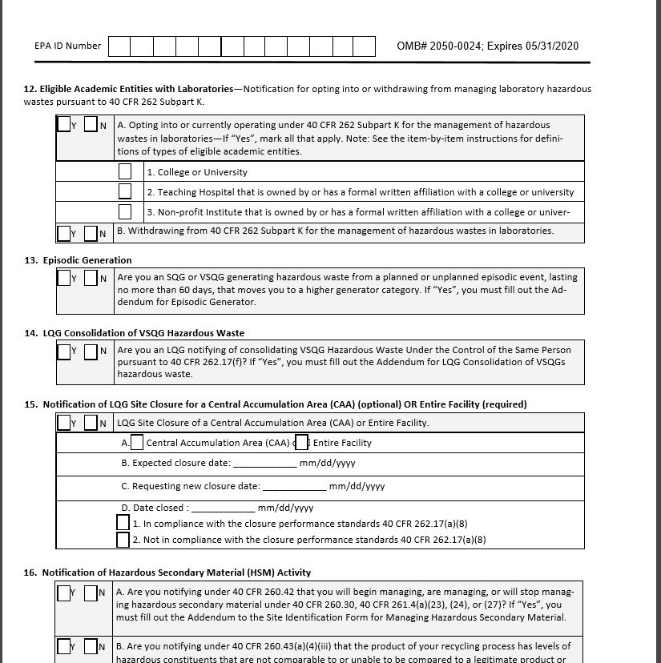
Item 13
EPISODIC GENERATION
YES OR NO
ARE YOU A VSQG OR SQG GENERATING HW FROM A PLANNED OR UNPLANNED EG EVENT, LASTING NO MORE THAN 60 DAYS, THAT MOVES YOU TO A HIGHER GENERATOR CATEGORY?
If yes, go to addendum

Slide 14
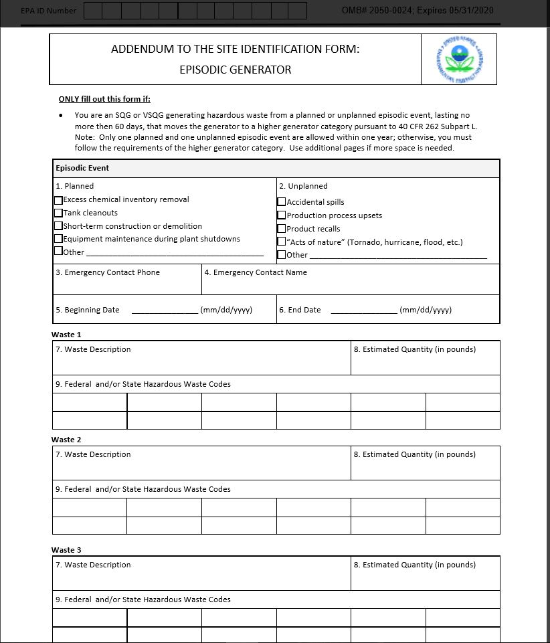
EG Addendum
Fill out 1 thru 9
Planned
Unplanned
Emergency contact phone
Emergency contact name
Beginning date
End date
Waste description
Estimated quantity (lbs.)
Fed & state waste codes

Slide 15
Unplanned Episodic Event
An episodic event that the generator did not plan or reasonably did not expect to occur, including:
Production process upset
Product recalls
Accidental spills
Acts of nature (hurricane, flood, tornado)

Slide 16
Unplanned Scenario
DIASTER CHEMICAL COMPANY – manufacturer of specialty chemicals
Generates 1,200 lbs. of HW in one calendar month yearly
Current category: SQG EPA ID #: NJD000111999
Scenario: Overfill alarm malfunction resulting in a 3,000-gallon product tank of sulfuric acid spill and discharge of sulfuric acid to ground, approximately 5,000-gallons lost. oh no!

Slide 17
Diaster Chemical Tank Overfill & Spill

Slide 18
Diaster Chemical – Do they Qualify for Episodic Generator? YES
Unplanned event that generate HW exceeding their category as SQG
24-hour Hot Line – report the spill of a hazardous substance
Call NJDEP – request episodic generation of spilled with 72 hours of event
Over 20,000 pounds of D002 corrosive waste removed from parking lot area within 24 hours of spill
SQG to LQG generation quantities of hazardous waste
Diaster Chemicals will store spilled material on site not to exceed 60-days from the onset of the spill
Label the 55-gallon drums “Episodic Waste” with start date and pictorial description of waste characteristics

Slide 19
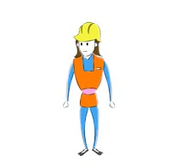
Who is Buildem Up LLC?
A minority-based developer
Large corporate entity
Small construction firm
Local family contractor
Any developer or builder, any size or situation
Does not possess an USEPA ID number
Not a hazardous waste generator
Found hazardous waste on site

Slide 20
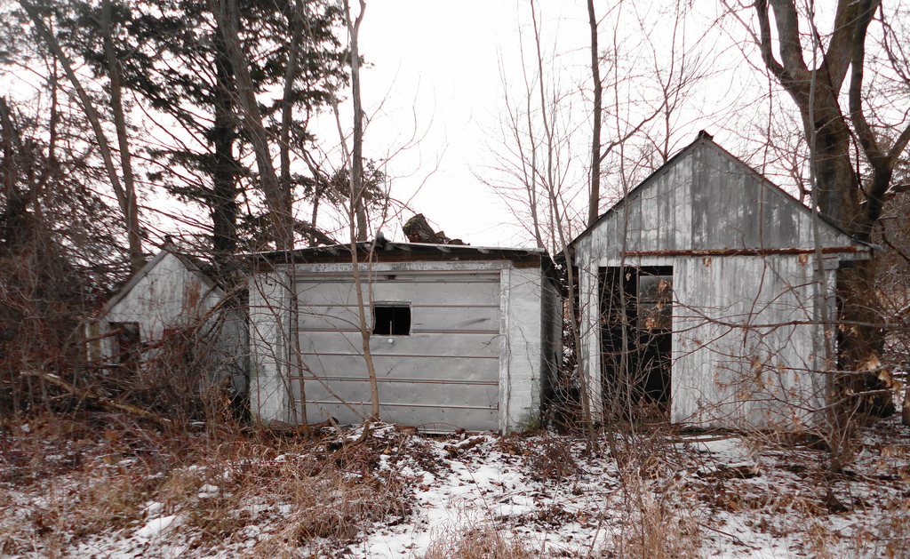
Buildem Up LLC
Current structures on property owned by Buildem Up LLC.
Are they eligible for Episodic Generation Alternative Standards?

Slide 21
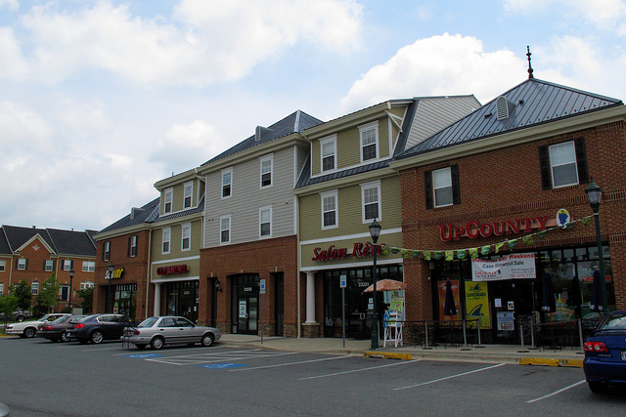
Buildem Up, LLC – Proposed Redevelopment Plan

Slide 22
Soil Excavation for Proposed Town Redevelopment Center Case Study – Buildem Up LLC
Current property owner is a developer. NOT a HW generator. No EPA ID number associated with the current property owner’s operation.
Previous property owner operated the site as an old garage
A LSRP is assigned to the property and has an approved remediation plan.
Small garage on the property is slated for demolition. MUST dispose of contaminated soils as hazardous waste.
Question: Can they use Episodic Generation alternative for accumulation and disposal?

Slide 23
Small Excavated Soil Pile found Contaminated Exceeding TCLP Lead

Slide 24
Buildem Up LLC
Excavation of soils adjacent to a old structure that was found to contain elevated levels of lead from a previous operation or historic contaminated fill.

Slide 25
Excavated Soil Piles found Contaminated with Lead Not Eligible for Episodic Generation –over 60 Days

Slide 26
Labels on Containers
THE WORDS “EPISODIC HAZARDOUS WASTE”
Hazardous waste characteristics
Ignitable
Corrosive
Reactive
Toxic
DOT labeling or placarding
Hazardous statement or pictogram (OSHA) or National Fire Protection (NFPA code)
Date of generation clearly visible for inspection on each container

Slide 27
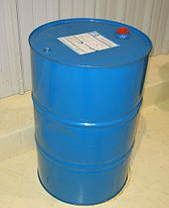
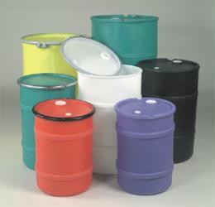
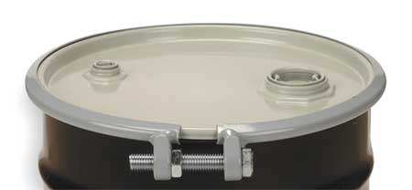
CONTAINER LABELING
“EPISODIC HAZARDOUS WASTE”
IGNITABLE
CORROSIVE This Photo by
REACTIVE
TOXIC
MARK THE DATE THE EPISODIC EVENT Began
CLEARLY VISIBLE

Slide 28
EG Requirements for HW Management
Containers in good condition, closed, no releases to air, soil, or water
Tanks in good condition, overflow system, inspected once each operating day, and must operate according to its design

Slide 29
PLACARDS/PICTOGRAMS
This Photo by Unknown Author is licensed under CC BY-SA

Slide 30
HW Manifest Waste Off Site
Comply with hazardous waste manifest requirements
Send to a designated TSD facility

Slide 31
60-Day Limitation for VSQG & SQG
From start of episodic event to
off site TSD = 60 days or less
for on-site accumulation

Slide 32
Recordkeeping for VSQG & SQG
Maintain records on site
Identify beginning and end dates of episodic event
Description of event
Description of types and quantities of HW generated
Description of TSD receiving the wastes
Name of transporter(s)
If EPA approved, letter to conduct one additional episodic event per calendar year

Slide 33
Off-Site Disposal Time Line
Ship to off site designated facility (TSD) within 60 days from the start of the episodic event

Slide 34
Helpful Phone Numbers
Phone #: NJDEP COMMUNICATION CENTER HOT LINE
24-hour a day, 7 days a week
1-877-WARN DEP (1-877-927-6337)
Contacts: Northern Field Office - 973-656-4470
Central Field Office - 609-292-3962
Southern Field Office - 856-614-3658

Slide 35
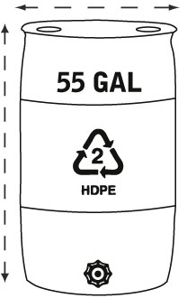
Thank you!

